Slide 1
SU Doctoral Rep Elections​
Guide to elections and promotion for Doctoral staff.

Slide 2
Promotion by University Staff
Promoting the importance of Doctoral Rep's to your cohort is key to getting nominations, if students see reps as powerful and respected, they will be motivated to want to step forward and put their names down for a rep role.
Expected practice
Directors of Studies emailing their student cohorts to promote the nominations and elections. If possible, detailing some of the wins from their previous academic reps.
Promoting nominations and elections by giving lecture shout outs at the start of Semester 1 and 2
Asking existing reps and our SU student officers to go into lectures to positively promote rep roles. Emphasis on communicating any personal wins.

Slide 3
Role Descriptions
More information about Doctoral Reps can be found on our “Become a Rep" page - this page is also ideal for linking students to a simple overview of the academic rep system.
The links below will open up a PDF role descriptor you can then download the file.
Doctoral Rep
Faculty Rep (Doctoral)

Slide 4
Email Templates & Signatures
The best practice for promotional emails is to CC pgvoice@bath.ac.uk into them. This way we can see how you are promoting the role and students know where they can send any queries. Here are some examples of emails that you can use:
Nomination Promotion Email
Voting Promotion Email
Email Signatures - how to add an elections banner to your e-sig

Slide 5

Email Signatures
Adding an image to the end of your email can be a passive way to promote elections every time you communicate with students.
Click here to find out how to add an elections banner to your e-sig

Slide 6
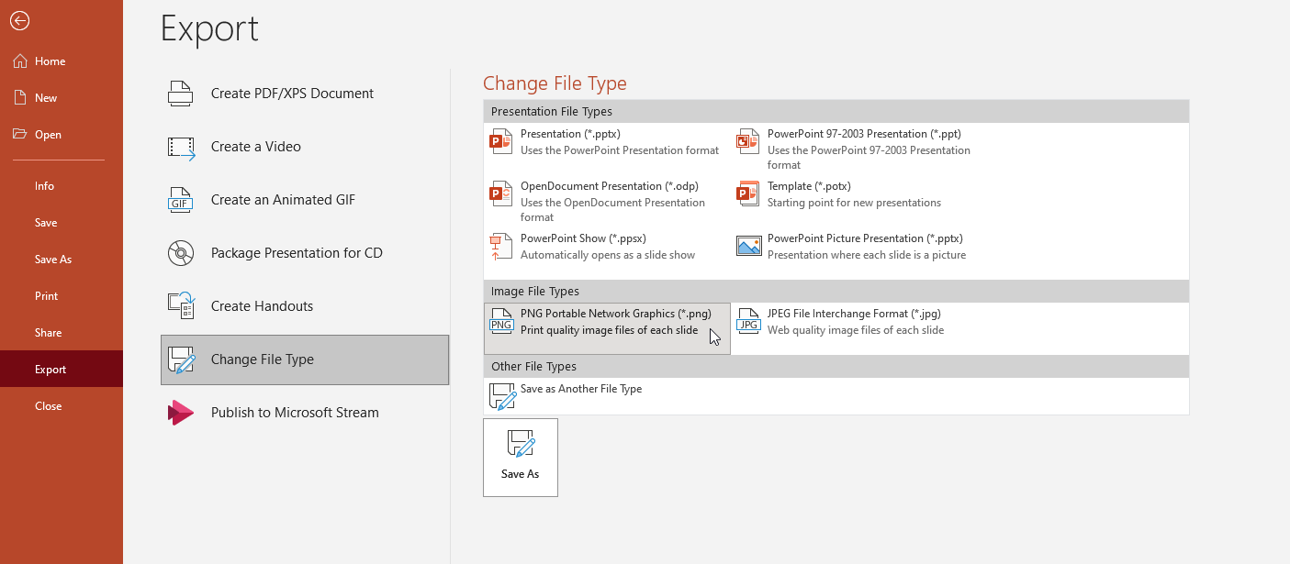
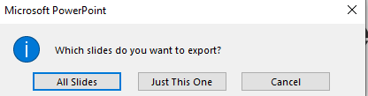
Digital Screens
The following slides can be downloaded and shown on screens around your department. You can do this by exporting this presentation into PNG files. Press File > Export > Change File Type > PNG > Save As. Once you have chosen it’s location, it will ask whether you want export “All Slides” or “Just This One”.

Slide 7


Be a
Doctoral Rep
Improve your doctoral experience.
Develop confidence.
Be part of positive change.
Nominations Close:
[DATE, TIME]
Stand online:
thesubath.com/elections

Slide 8

Vote for your
Doctoral Rep
Your Doctoral Rep can voice the changes that you want to see.
Who do you want to represent you?
Make your Choice and vote online.
Voting Closes: [DATE, TIME]
Vote now: thesubath.com/elections

Slide 9
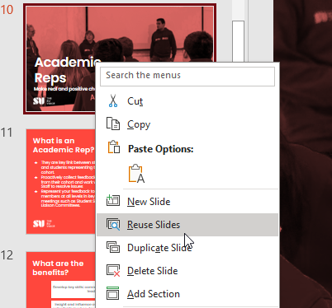
PowerPoint Presentations
The following slides can be added to a lecture and goes over the elements of being a Rep and what they get out of it. Simply press reuse slides and browse for the relevant PowerPoint file on your PC or X Drive.

Slide 10
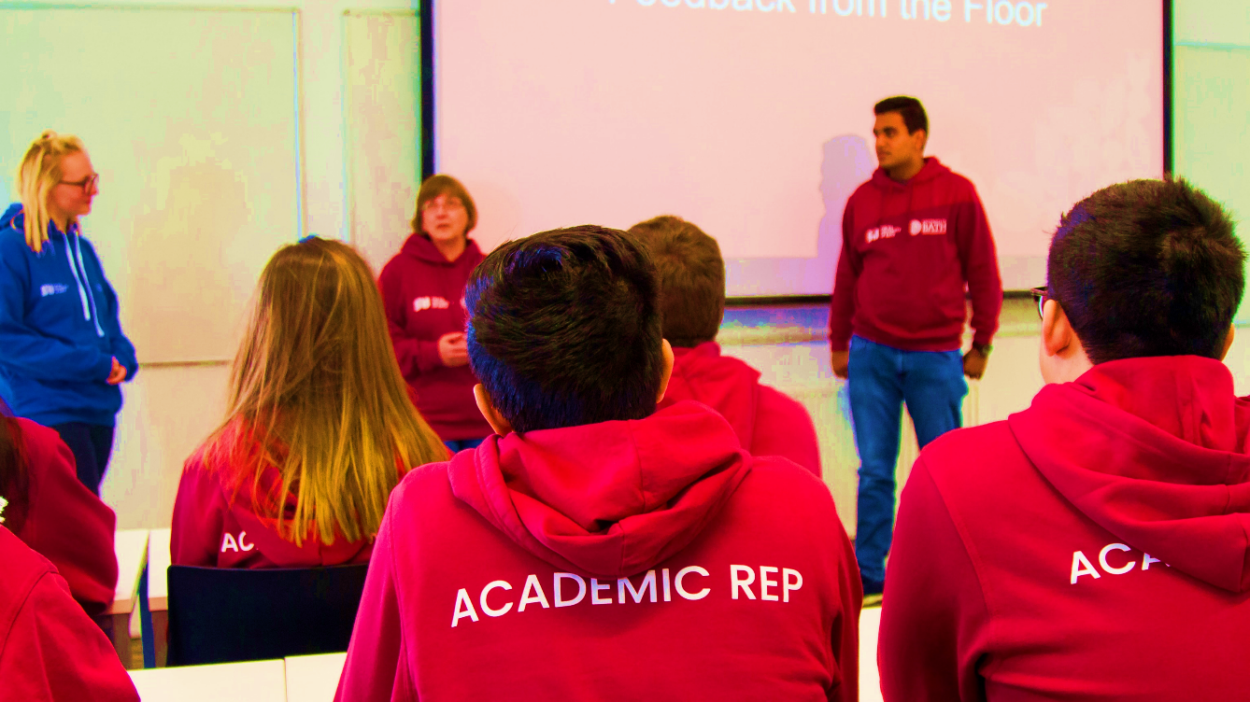
Doctoral Reps
Make real and positive change
thesubath
thesubath.com/academicreps

Slide 11
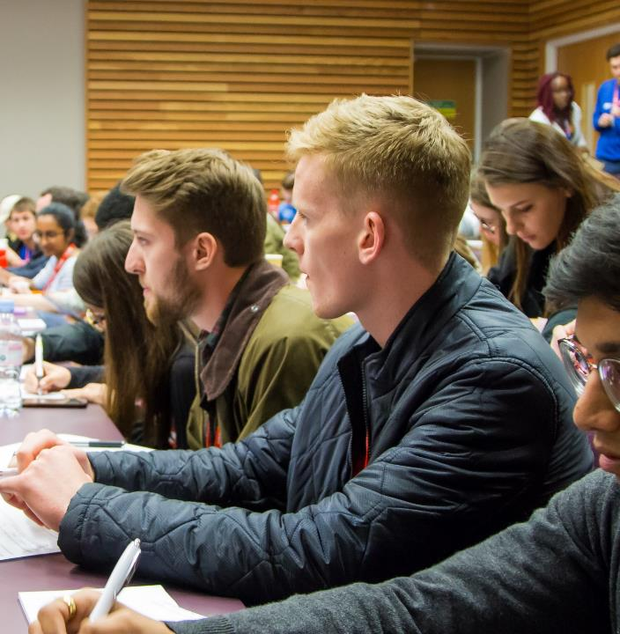
What is a Doctoral Rep?
They are key link between Doctoral staff and students representing their cohort.
Proactively collect feedback from their cohort and work with Doctoral Staff to resolve issues
Represent your feedback to staff members at all levels in key meetings such as Student Staff Liaison Committees, SU Council
thesubath
thesubath.com/academicreps

Slide 12
What are the benefits?
Develop key skills: communication, confidence, negotiation, problem-solving, leadership, data collection, and more
Insight and influence over how your course is managed and run. You have potential to lead on developing positive change through by working as team with your fellow reps, academic staff & SU
Get freebies and attend socials to thank you for your contribution towards the academic experience
thesubath
thesubath.com/academicreps

Slide 13
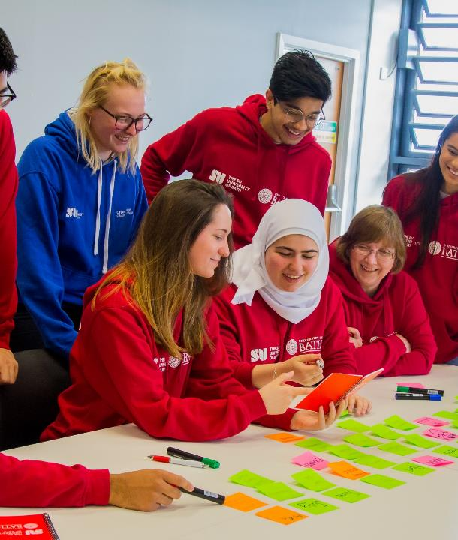
How do I become a Doctoral Rep?
1) Nominate yourself now!
  Nominations close: [DATE] at [TIME]
2) Get votes
  Voting opens: [DATE] at [TIME]
  Voting closes: [DATE] at [TIME]
Nominate and vote at:
thesubath.com/elections
thesubath
thesubath.com/academicreps

Slide 14
Video Promotion
We find that students hearing from other Reps about their experience can be invaluable for recruitment numbers. You can choose to add these to the end of a lecture or send it in an email for students to watch in their own time.
We also have a video all about how to nominate yourself using the SU website, which can be helpful if you are aware of students who are struggling to do so.

Slide 15
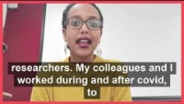
Why you should be an Academic Rep - Taghried (Doctoral)
https://youtu.be/SOLHA68lnTU
Notes:
https://youtu.be/SOLHA68lnTU

Slide 16
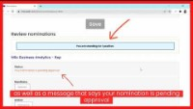
How to Nominate Yourself in an Election
https://youtu.be/HtIOayZImUg
Notes:
https://youtu.be/SOLHA68lnTU

